Slide 2
Light-Emitting Diodes (LEDs)
For optical communication systems requiring bit rates less than approximately 100–200 Mb/s together with multimode fiber-coupled optical power in the tens of microwatts, semiconductor light-emitting diodes (LEDs) are usually the best light source choice.
These LEDs require
Less complex drive circuitry than laser diodes
No thermal or optical stabilization circuits are needed
They can be fabricated less expensively with higher yields.

Slide 3
LED Structures
To be useful in fiber transmission applications, an LED must have a high radiance output, a fast emission response time, and a high quantum efficiency.
Its radiance (or brightness) is a measure, in watts, of the optical power radiated into a unit solid angle per unit area of the emitting surface.
High radiances are necessary to couple sufficiently high optical power levels into a fiber.
The emission response time is the time delay between the application of a current pulse and the onset of optical emission.
This time delay is the factor limiting the bandwidth with which the source can be modulated directly by varying the injected current.
The quantum efficiency is related to the fraction of injected electron–hole pairs that recombine radiatively.

Slide 4
To achieve a high radiance and a high quantum efficiency, the LED structure must provide a means of confining the charge carriers and the stimulated optical emission to the active region of the pn junction where radiative recombination takes place.
Carrier confinement is used to achieve a high level of radiative recombination in the active region of the device, which yields a high quantum efficiency.
Optical confinement is of importance for preventing absorption of the emitted radiation by the material surrounding the pn junction.

Slide 5
LED DESIGNS
Two basic structures of LED are in use. These are (i) surface-emitting LED (SLED) and (ii) edge-emitting LED (ELED).
Configurations based on GaAs/ GaAlAs have been used in short-haul applications, whereas those based on InGaAsP/ InP have been employed in medium-range fiber links.
Relatively recently, a third device known as a super luminescent diode (SLD) has also been increasingly used in communications.

Slide 6
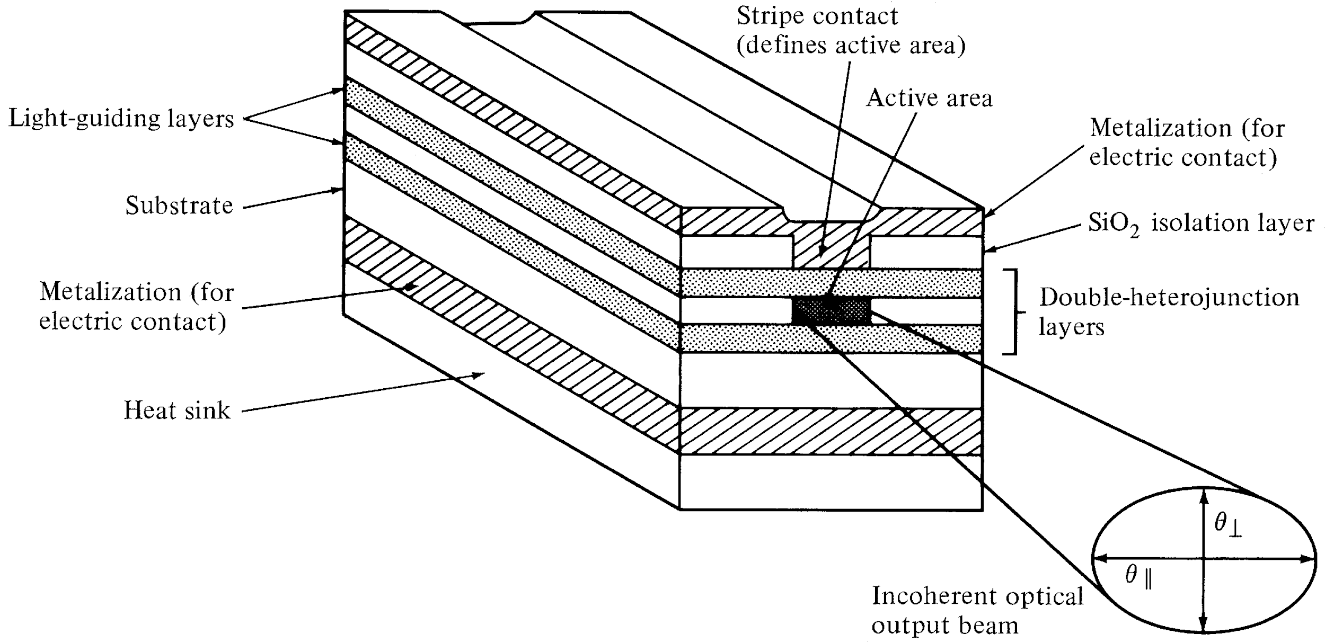
Edge-Emitting LED
Schematic of an edge-emitting double heterojunction LED. The output beam is
lambertian in the plane of junction and highly directional perpendicular to pn junction.
They have high quantum efficiency & fast response.
Optical Fiber communications, 3rd ed.,G.Keiser,McGrawHill, 2000

Slide 7
It is widely used in optical fiber communication system.
Here collimated light from LED is required to be fed into the fiber
with high coupling efficiency.
The figure depicts multilayer structure of InP based edge emitting LED.
It is used for long wavelength optical communication approx. between 1.33 to 1.55 µm.
Modern epitaxial growth techniques such as Molecular Beam Epitaxy (MBE), Metal-Organic Chemical Vapor Deposition (MOCVD) are used in order to design such complex LED structures.
The structure consists of five epitaxial layers.
Central active layer is made using InGaAs having narrow bandgap.
It is bounded by wide bandgap layers such as p+ InGaAsP and n+ InP cladding layers.
The positive contact is in the form of a stripe (the rest of the contact being isolated by the SiO2 layer).
These two cladding layers help in confining injected electrons and holes into the middle layer.
It also helps emitted photons to travel along LED axis as per optical properties.

Slide 8
Due to above, light is emitted from the edge of the LED. Hence it is known by the name edge emitting LED.
The rear-end facet is made reflecting while the front-end facet is coated with an antireflection coating, so that the laser action due to optical feedback is suppressed.
The self-absorption of radiation in the active layer is reduced because its thickness is made very small.
Much of the guided radiation propagates through the confining layers, which have a wider band gap. Therefore, they do not absorb this radiation.
The recombination radiation generated in the active region is guided by internal reflection at the heterojunctions and is brought out at the front-end facet of the diode.
An important effect of the optical guidance of emitted radiation is that the output beam has low divergence (typically ~30°) in the vertical direction.
This increases the efficiency of coupling the LED with the optical fiber.
Stripe geometry ELEDs based on InP/In GaAsP materials and with improved designs for coupling to single-mode fibers have also been made.
The optical power obtained from such a structure is 2 to 6 times smaller than that of a Surface emitting LED but more efficient coupling due to narrow band width.

Slide 9
Advantages of Edge Emitting LED
Following are the benefits or advantages of Edge Emitting LED: ➨It has superior beam collimation property which offers greater coupling efficiency with fiber optic cable compare to surface emitting LED. ➨It offers higher efficiency with low to high radiance. It fulfills high brightness LED requirements of the lighting industry. ➨It radiates less power to the air compare to surface emitting LED due to reabsorption and interfacial recombination. ➨It offers better modulation bandwidth and more directional emission pattern. ➨It offers 5-6 times more coupled power into NA (Numerical Aperture) of step/graded index fibers. This is due to small beam divergence. ➨It offers high data rates (> 20 Mbps) than surface emitting LED.

Slide 10
Disadvantages of Edge Emitting LED
Following are the drawbacks or disadvantages of Edge Emitting LED: ➨Its structure is complex. ➨It is difficult to design heat sink. ➨It is expensive compare to other LED types. ➨There are many issues to be handled during mechanical mounting and installation.

